Slide 1
AWS Services - AutoScaling
January 2015

Slide 2
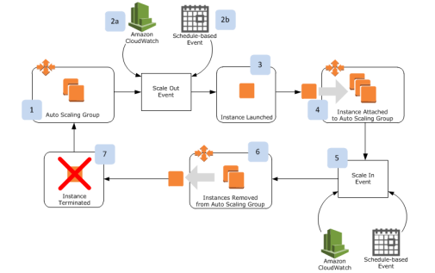
AUTOSCALING
Auto Scaling is Amazon’s hosted service for automatically launching and terminating EC2 instances.

Slide 3
AUTOSCALING - Features
Increases service availability and reliability.
Cost optimization. Increase or decrease in capacity only when needed.
Fault tolerant.
Auto Scaling automatically redistributes the application instances evenly across all of the designated Availability Zones.
Auto Scaling group cannot span multiple regions.

Slide 4
AutoScaling Group
Logical grouping of EC2 instance sharing similar characteristics.
An AWS Account can have 20 AutoScaling groups.
In a Auto Scaling group,
Decide the launch Configuration
Decide the Group size
Decide the scaling policy
aws autoscaling create-auto-scaling-group --auto-scaling-group-name my-test-asg --launch-configuration-name my-test-lc --max-size 5 --min-size 1 --availabilityzones "us-east-1e"

Slide 5
Create a Launch Configuration
Templates that describe the parameters passed at launch-time to your EC2 instances
Choose AMI, Instance type, Security group and keypair for the instances launched in the Auto scaling group
aws autoscaling create-launch-configuration \
--launch-configuration-name my-test-lc \
--image-id ami-12345678 \
--key-name my-keypair \
--securty-groups default \
--instance-type c1.xlarge

Slide 6
Scaling Policy
Scaling is the ability to increase or decrease the compute capacity of your application. Scaling starts with an event, or scaling action, which instructs Auto Scaling to either launch or terminate EC2 instances
Each group can have more than one policy to scale in/out.
AutoScaling Scale In/Out Events can be due to the below actions
Manual Scaling
Scale based on a schedule
Scale based on demand
When two scaling events gets triggered at the same time, the one with the greatest impact will run.

Slide 7
Manual Scaling
Manually change the desired capacity field in the Autoscaling group details tab.
Verify the same using the Scaling History Tab.

Slide 8
Scaling Based on Demand
Create scaling policies that tell the Auto Scaling group what to do when the specified conditions change.
Create alarms by identifying the metrics to watch, defining the conditions for scaling, and then associating the alarms with the scaling policies.

Slide 9
Scaling Based on Schedule
Scaling based on a schedule allows you to scale your application in response to predictable load changes
To configure your Auto Scaling group to scale based on a schedule, you need to create scheduled actions.
You can schedule a scheduled action for up to a month in the future.
To create a scheduled scaling action, you specify the start time at which you want the scaling action to take effect, and you specify the new minimum, maximum, and desired size you want for that group at that time
You can create scheduled actions for scaling one time only or for scaling on a recurring schedule

Slide 10
AUTOSCALING – Instance Distribution
Attempts to launch new instances in the Availability Zone with the fewest instances
When one Availability Zone becomes unhealthy or unavailable, Auto Scaling launches new instances in an unaffected Availability Zone.
When the unhealthy Availability Zone returns to a healthy state, Auto Scaling automatically redistributes the application instances evenly across all of the designated Availability Zones

Slide 11
Thank you

